Slide 1
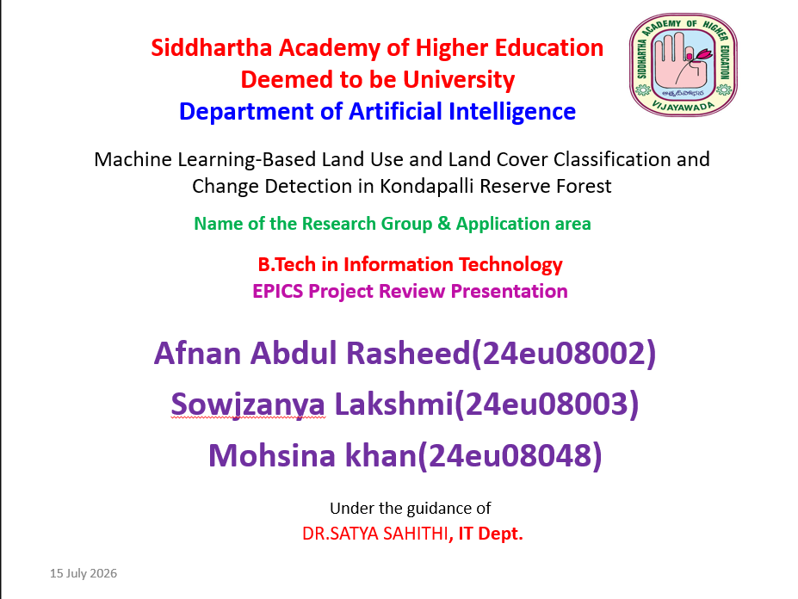

Slide 2
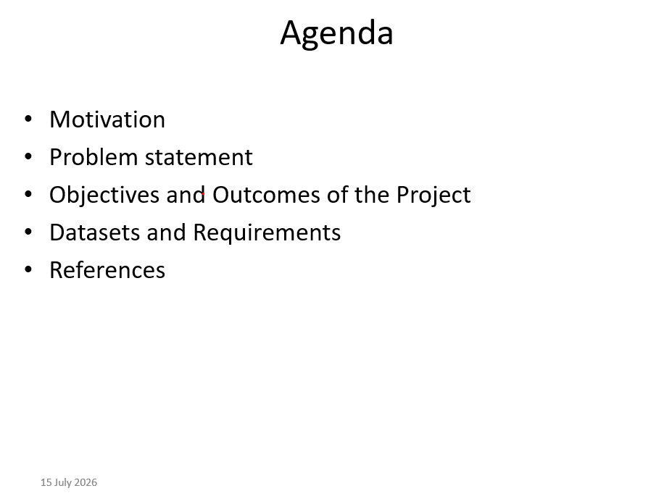

Slide 3
Machine Learning-Based Land Use and Land Cover Classification and Change Detection in Kondapalli Reserve Forest
TEAM MEMBERS:
24EU08003
24EU08048
24EU08002
GUIDE NAME: DR.SATYA SAHITHI

Slide 4
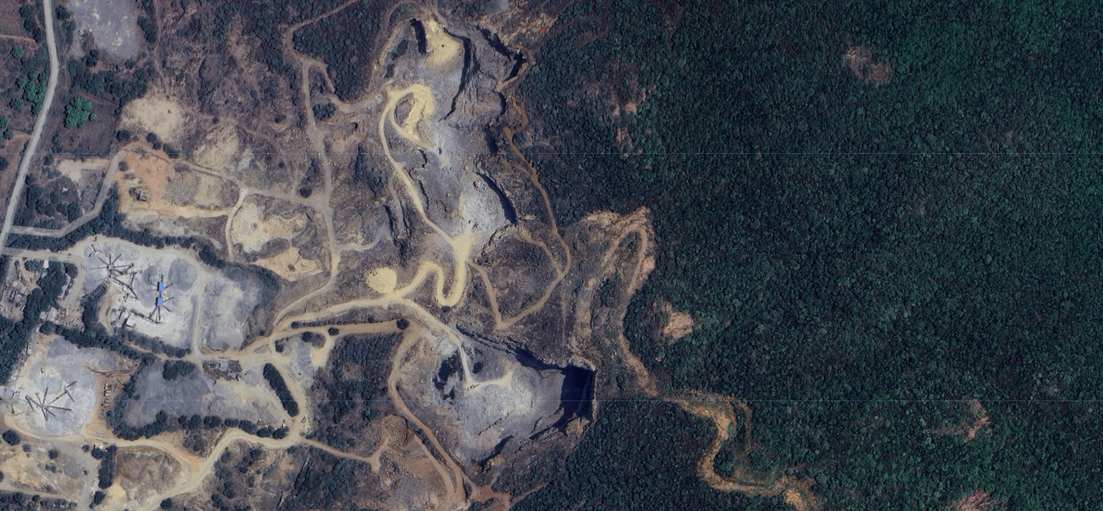
Problem Statement
Kondapalli Reserve Forest is facing deforestation and increasing air pollution due to human activities and urban development. There is a need to monitor these changes using satellite imagery and Machine Learning to support effective forest conservation and environmental management.

Slide 5
Motivation
Protect the Kondapalli Reserve Forest from increasing deforestation.
Monitor environmental changes using satellite imagery.
Analyze the impact of air pollution on the forest ecosystem.
Apply Machine Learning for accurate land cover classification and prediction.
Support sustainable forest management and conservation efforts.

Slide 6
Objectives & Outcomes of the Project
Objectives of the Project
Monitor deforestation in Kondapalli Reserve Forest using satellite imagery.
Analyze air pollution and its impact on the forest environment.
Perform Land Use and Land Cover (LULC) classification over multiple decades using Machine Learning.
Expected Outcomes of the Project
Accurate of the Kondapalli Reserve Forest.
Identification LULC maps of deforestation trends and affected areas.
Analysis of air pollution patterns in the study area.
Prediction of future forest cover and land use changes.
A decision-support system for environmental monitoring and sustainable forest management.
Multi-decadal LULC classification maps.

Slide 7
Datasets and Requirements
Datasets
Sentinel-2 Satellite Images
Landsat 8/9 Images
Sentinel-5P Air Pollution Data
Kondapalli Forest Boundary
Google Earth/ESA WorldCover (Reference Data)
Requirements
Google Earth Engine
Google Earth Pro
Python & JavaScript
Google Colab/Jupyter Notebook
Scikit-learn, NumPy, Pandas, Matplotlib
Google Earth Engine (GEE)is used to detect deforestation, map urban expansion, monitor water resources, and track climate trends changes.

Slide 8
References
Google Earth Engine Documentation https://developers.google.com/earth-engine
Copernicus Sentinel-2 Data https://dataspace.copernicus.eu
USGS Landsat Missions https://www.usgs.gov/landsat-missions
Copernicus Sentinel-5P Data https://sentinels.copernicus.eu
ESA WorldCover Dataset https://worldcover2021.esa.int
Scikit-learn Documentation https://scikit-learn.org
Research Papers on Land Use/Land Cover Classification and Deforestation Monitoring Using Machine Learning

Slide 9

THANK YOU

